Slide 1

Economic Freedom Analysis
Team: Freedom Riders
Project #1
July 18, 2019

Slide 2
Project summary
Our project consisted of reviewing the economic freedom index and its components over the last 10 years.

Slide 3
Definition
What is economic freedom?
Economic freedom is fundamental right of every human to control his/her own labor and property. In an economically free society, individuals are free to work, produce, consume and invest in any way they please. Also, governments allow labor, capital and goods to move freely and refrain from coercion or constraint of liberty beyond the extent necessary to protect and maintain liberty itself.

Slide 4
Economic Freedom Index Score Ratings
> 80 : “free”
70 – 79.9 : ”mostly free”
60 – 69.9 : “moderately free ”
50 – 59.9 : ”mostly unfree”
< 50 : “repressed”

Slide 5
Four Economic Freedom Pillars
Rule of Law
Property Rights
Government Integrity
(Judicial Effectiveness)
Government Size
Tax Burden
Government Spending
(Fiscal Health)
Regulatory Efficiency
Business Freedom
Labor Freedom
Monetary Freedom
Open Markets
Trade Freedom
Investment Freedom
Financial Freedom

Slide 6
Questions
1. What countries have the most economic freedom?
2. What countries have the least economic freedom?
3. What countries experienced the largest change in economic freedom, both positive and negative, between 2010 and 2019?
4. Of the countries that experienced the most change; what regions are they located in?
5.

Slide 7


Which countries (by region) have the highest & lowest overall average scores for the years of 2010 & 2019?
Use a bar chart to compare overall scores by region for the year 2010 and the year 2019 to show before and after effects of recession on the entire globe for economic freedom satisfactions.

Slide 8
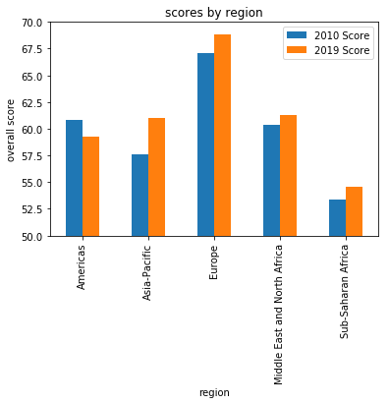
Findings:
Europe has the highest overall freedom satisfaction for both years and Sub-Saharan Africa has the lowest average scores for 2010 and 2019 compared to other regions.
The Americas were the only region that didn’t improve overall scores.

Slide 9


How did the specific individual freedom categories vary over the 10-year time period for just the United States?
Use a line graph to compare each economic freedom score for the years 2010 through 2019 to show before and after effects of recession on the US.

Slide 10
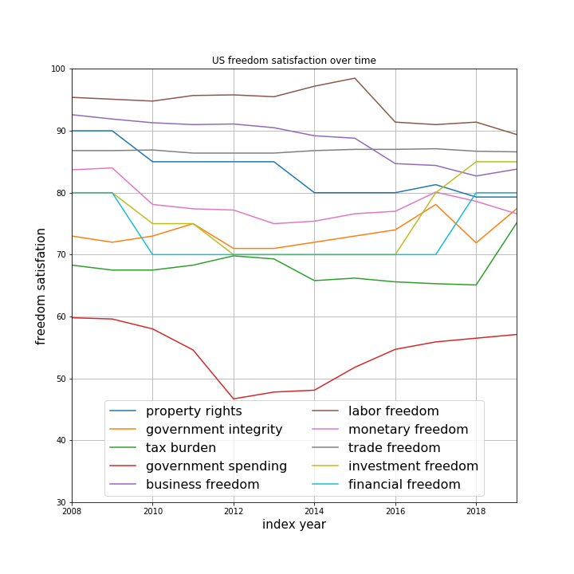
Findings:
Government spending satisfaction started and ended with the lowest score. The US seems to be most satisfied with our labor freedom. The trade freedom satisfaction category appeared to remain the most unchanged from 2008 – 2019.

Slide 11
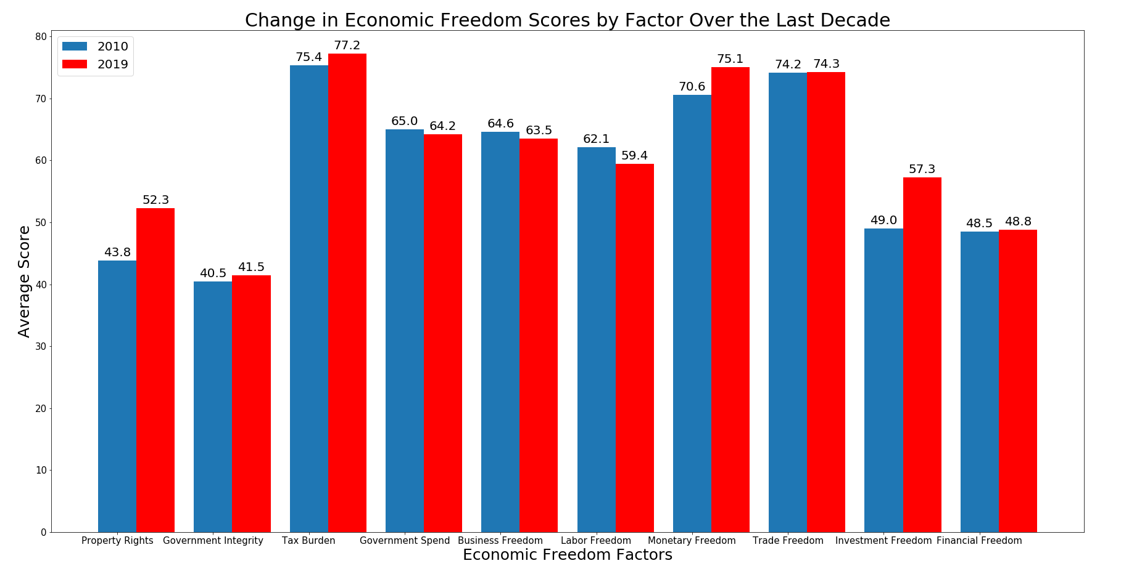
What factors have led the improvement in global economic freedom over the last decade? Do these factors differ from the ones that led the advancement over the last quarter century?

Slide 12
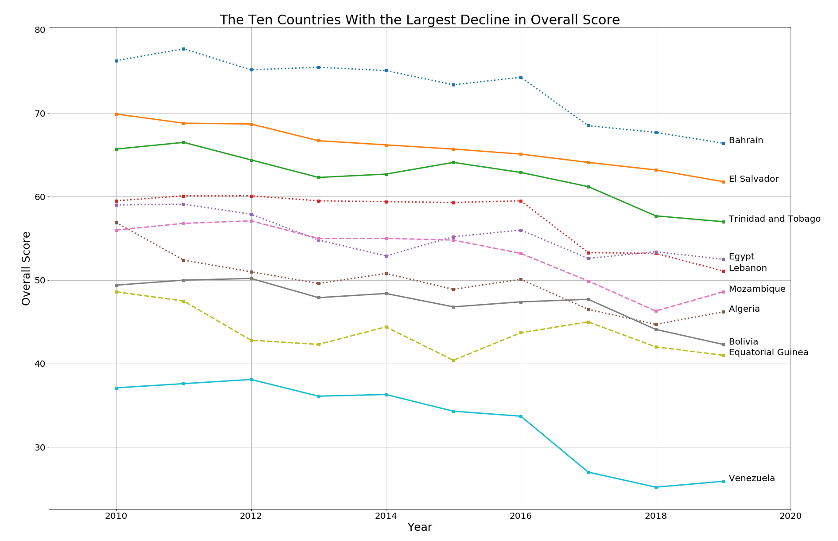
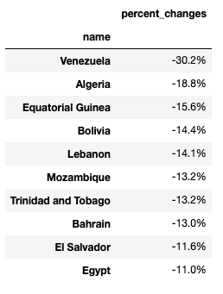
Which 10 countries suffered from the largest percentage declines in their overall score? Also, were these score declines concentrated in similar economic pillars for each country?

Slide 13
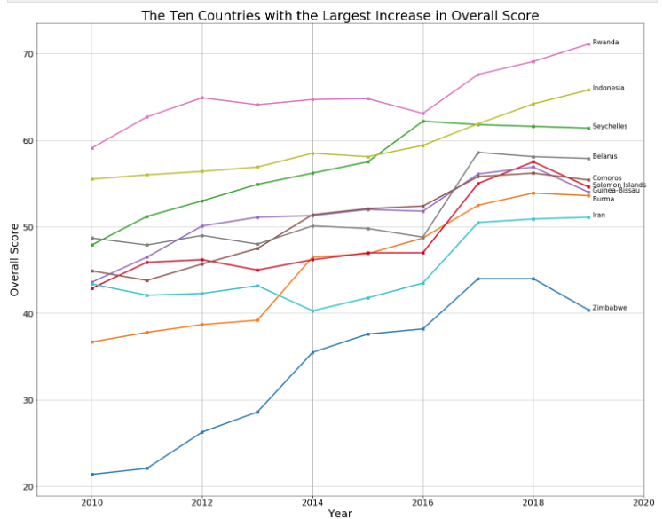
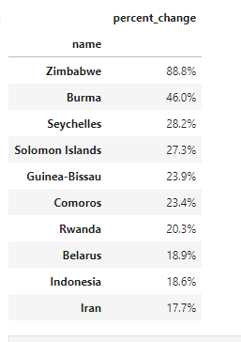
Which 10 countries experienced the largest percentage increases in their overall score?

Slide 14
